Slide 1
DotShots
Final Report

Slide 2
01
Introduction
We have decided to pitch our idea on the theme Education and Technology by using Web and App development to overcome the challenges faced by the students and teachers while also giving them an option and opportunity exploring new fields on their own, we come up with this idea in order to solve the entangled management of time due to time wastage caused during the idle periods

Slide 3

OUR IDEA
Our goal is to establish a method to interconnect Students to Students and Teachers and also the other way around.
Not only should Students be able to learn through teachers but also by communicating with other students out of their own interest.

Slide 4
02
Technology Used
We Have used Website and Application Development as out basic tools to impliment this idea.
https://github.com/Abhinish098/Hackathon-2020

Slide 5
Key Points as response to the Problem Statement
With reference to the problem we are facing as mentioned:
So we came up with the following solution for them in short:
Students not being able to join a video lecture by their respective teacher because of a set limitation to the number of participants pre-defined by the organization whose technology is being used.
Demotivating and boring leasure hours and the time that gets wasted sitting idle due to lack of resources .
Teachers here are given the dynamic power to decide the upper limit of how many students he/she wants to accumulate in the online class.
A dynamic platform is made in which the user can interact with other users and to get hands on collaboration and expand their network while they learn peer to peer.

Slide 6
03
But Why Come Up With Such An Idea?
For the very reason that there are students that love to explore and learn new things besides their coursework and people of this caliber unfortunately have to work very hard in order to find other people of similar interests, we are trying to make things easier for them by taking this online and by doing thiswe are not only solving their problem but also making it easier for teachers to interact with their students.

Slide 7
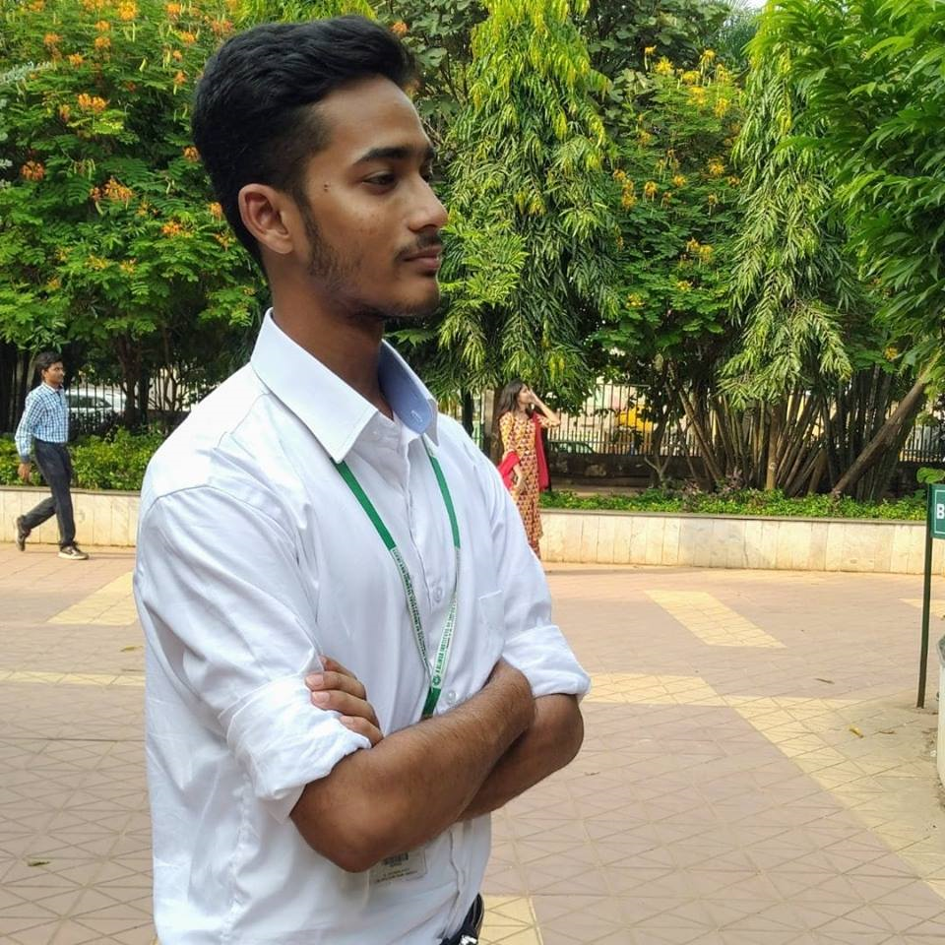
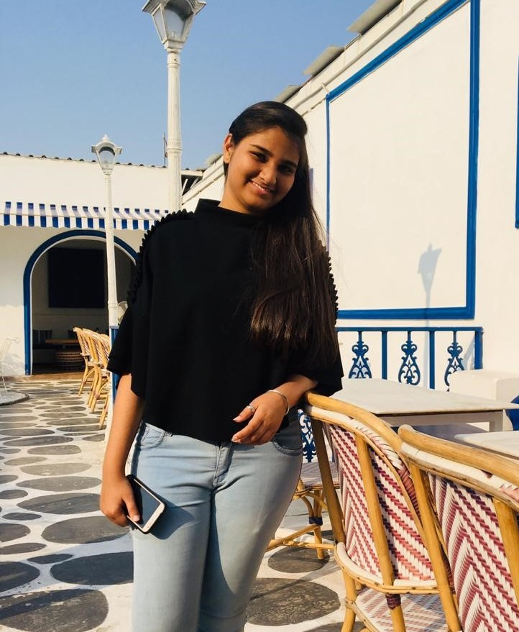
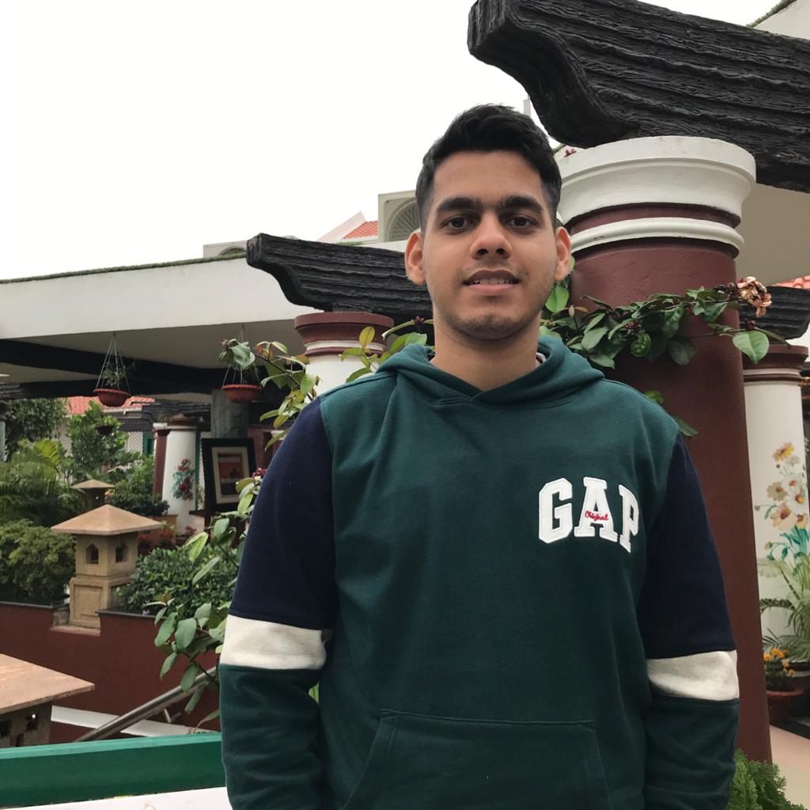
TEAM
Abhinish Sharma
Rashmita Panda
Abhishek Das
Team leader
KIIT University
!806005@kiit.ac.in
Team Member
KIIT University
!806005@kiit.ac.in
Team Member
KIIT University
!806005@kiit.ac.in

Slide 8
THANK YOU
END
Reporter：DotShots

